Slide 1
Bootstrap Buttons
廖向德

Slide 2
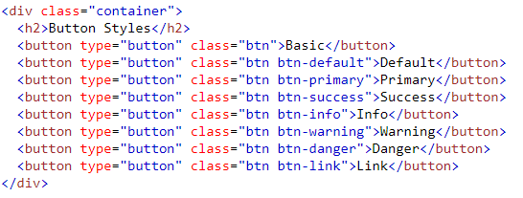
Button Styles
To achieve the button styles above, Bootstrap has the following classes:
.btn
.btn-default
.btn-primary
.btn-success
.btn-info
.btn-warning
.btn-danger
.btn-link
The button classes can be used on an <a>, <button>, or <input> element. Try it.
Notes:
<!DOCTYPE html>
<html lang="en">
<head>
<title>Bootstrap Example</title>
<meta charset="utf-8">
<meta name="viewport" content="width=device-width, initial-scale=1">
<link rel="stylesheet" href="https://maxcdn.bootstrapcdn.com/bootstrap/3.3.7/css/bootstrap.min.css">
<script src="https://ajax.googleapis.com/ajax/libs/jquery/3.2.1/jquery.min.js"></script>
<script src="https://maxcdn.bootstrapcdn.com/bootstrap/3.3.7/js/bootstrap.min.js"></script>
</head>
<body>
<div class="container">
<h2>Button Styles</h2>
<button type="button" class="btn">Basic</button>
<button type="button" class="btn btn-default">Default</button>
<button type="button" class="btn btn-primary">Primary</button>
<button type="button" class="btn btn-success">Success</button>
<button type="button" class="btn btn-info">Info</button>
<button type="button" class="btn btn-warning">Warning</button>
<button type="button" class="btn btn-danger">Danger</button>
<button type="button" class="btn btn-link">Link</button>
</div>
</body>
</html>

Slide 3
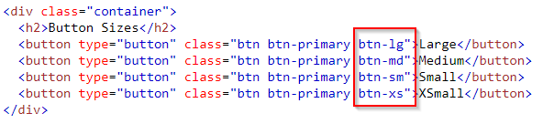
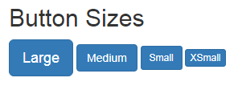
Button Sizes
Notes:
<!DOCTYPE html>
<html lang="en">
<head>
<title>Bootstrap Example</title>
<meta charset="utf-8">
<meta name="viewport" content="width=device-width, initial-scale=1">
<link rel="stylesheet" href="https://maxcdn.bootstrapcdn.com/bootstrap/3.3.7/css/bootstrap.min.css">
<script src="https://ajax.googleapis.com/ajax/libs/jquery/3.2.1/jquery.min.js"></script>
<script src="https://maxcdn.bootstrapcdn.com/bootstrap/3.3.7/js/bootstrap.min.js"></script>
</head>
<body>
<div class="container">
<h2>Button Sizes</h2>
<button type="button" class="btn btn-primary btn-lg">Large</button>
<button type="button" class="btn btn-primary btn-md">Medium</button>
<button type="button" class="btn btn-primary btn-sm">Small</button>
<button type="button" class="btn btn-primary btn-xs">XSmall</button>
</div>
</body>
</html>

Slide 4
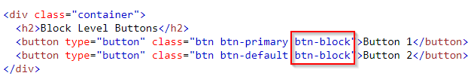
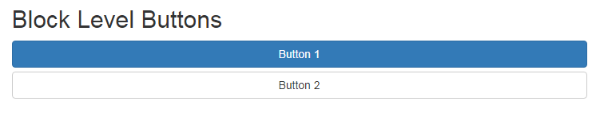
Block Level Buttons
A block level button spans the entire width of the parent element.
Add class .btn-block to create a block level button
Notes:
<!DOCTYPE html>
<html lang="en">
<head>
<title>Bootstrap Example</title>
<meta charset="utf-8">
<meta name="viewport" content="width=device-width, initial-scale=1">
<link rel="stylesheet" href="https://maxcdn.bootstrapcdn.com/bootstrap/3.3.7/css/bootstrap.min.css">
<script src="https://ajax.googleapis.com/ajax/libs/jquery/3.2.1/jquery.min.js"></script>
<script src="https://maxcdn.bootstrapcdn.com/bootstrap/3.3.7/js/bootstrap.min.js"></script>
</head>
<body>
<div class="container">
<h2>Block Level Buttons</h2>
<button type="button" class="btn btn-primary btn-block">Button 1</button>
<button type="button" class="btn btn-default btn-block">Button 2</button>
<h2>Large Block Level Buttons</h2>
<button type="button" class="btn btn-primary btn-lg btn-block">Button 1</button>
<button type="button" class="btn btn-default btn-lg btn-block">Button 2</button>
<h2>Small Block Level Buttons</h2>
<button type="button" class="btn btn-primary btn-sm btn-block">Button 1</button>
<button type="button" class="btn btn-default btn-sm btn-block">Button 2</button>
</div>
</body>
</html>

Slide 5
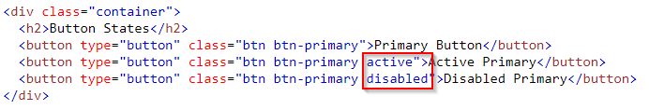
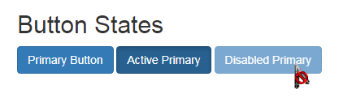
Active/Disabled Buttons
A button can be set to an active (appear pressed) or a disabled (unclickable) state
The class .active makes a button appear pressed, and the class .disabled makes a button unclickable
Notes:
<!DOCTYPE html>
<html lang="en">
<head>
<title>Bootstrap Example</title>
<meta charset="utf-8">
<meta name="viewport" content="width=device-width, initial-scale=1">
<link rel="stylesheet" href="https://maxcdn.bootstrapcdn.com/bootstrap/3.3.7/css/bootstrap.min.css">
<script src="https://ajax.googleapis.com/ajax/libs/jquery/3.2.1/jquery.min.js"></script>
<script src="https://maxcdn.bootstrapcdn.com/bootstrap/3.3.7/js/bootstrap.min.js"></script>
</head>
<body>
<div class="container">
<h2>Button States</h2>
<button type="button" class="btn btn-primary">Primary Button</button>
<button type="button" class="btn btn-primary active">Active Primary</button>
<button type="button" class="btn btn-primary disabled">Disabled Primary</button>
</div>
</body>
</html>

Slide 6
Button Groups

Slide 7
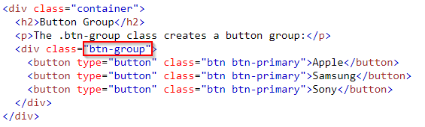
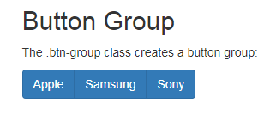
Button Groups
Bootstrap allows you to group a series of buttons together (on a single line) in a button group
Use a <div> element with class .btn-group to create a button group
Notes:
<!DOCTYPE html>
<html lang="en">
<head>
<title>Bootstrap Example</title>
<meta charset="utf-8">
<meta name="viewport" content="width=device-width, initial-scale=1">
<link rel="stylesheet" href="https://maxcdn.bootstrapcdn.com/bootstrap/3.3.7/css/bootstrap.min.css">
<script src="https://ajax.googleapis.com/ajax/libs/jquery/3.2.1/jquery.min.js"></script>
<script src="https://maxcdn.bootstrapcdn.com/bootstrap/3.3.7/js/bootstrap.min.js"></script>
</head>
<body>
<div class="container">
<h2>Button Group</h2>
<p>The .btn-group class creates a button group:</p>
<div class="btn-group">
<button type="button" class="btn btn-primary">Apple</button>
<button type="button" class="btn btn-primary">Samsung</button>
<button type="button" class="btn btn-primary">Sony</button>
</div>
</div>
</body>
</html>

Slide 8
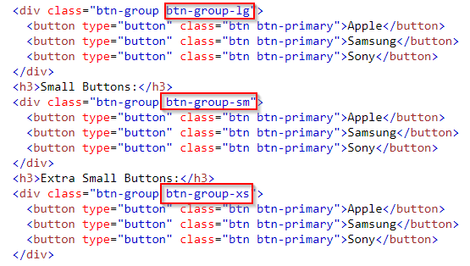
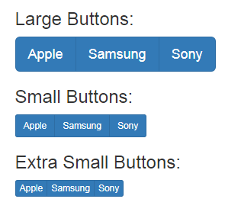
Button Group Set Size
Instead of applying button sizes to every button in a group, use class .btn-group-lg|sm|xs to size all buttons in the group
Notes:
<!DOCTYPE html>
<html lang="en">
<head>
<title>Bootstrap Example</title>
<meta charset="utf-8">
<meta name="viewport" content="width=device-width, initial-scale=1">
<link rel="stylesheet" href="https://maxcdn.bootstrapcdn.com/bootstrap/3.3.7/css/bootstrap.min.css">
<script src="https://ajax.googleapis.com/ajax/libs/jquery/3.2.1/jquery.min.js"></script>
<script src="https://maxcdn.bootstrapcdn.com/bootstrap/3.3.7/js/bootstrap.min.js"></script>
</head>
<body>
<div class="container">
<h2>Button Groups - Set Sizes</h2>
<p>Add class .btn-group-* to size all buttons in a button group.</p>
<h3>Large Buttons:</h3>
<div class="btn-group btn-group-lg">
<button type="button" class="btn btn-primary">Apple</button>
<button type="button" class="btn btn-primary">Samsung</button>
<button type="button" class="btn btn-primary">Sony</button>
</div>
<h3>Default Buttons:</h3>
<div class="btn-group">
<button type="button" class="btn btn-primary">Apple</button>
<button type="button" class="btn btn-primary">Samsung</button>
<button type="button" class="btn btn-primary">Sony</button>
</div>
<h3>Small Buttons:</h3>
<div class="btn-group btn-group-sm">
<button type="button" class="btn btn-primary">Apple</button>
<button type="button" class="btn btn-primary">Samsung</button>
<button type="button" class="btn btn-primary">Sony</button>
</div>
<h3>Extra Small Buttons:</h3>
<div class="btn-group btn-group-xs">
<button type="button" class="btn btn-primary">Apple</button>
<button type="button" class="btn btn-primary">Samsung</button>
<button type="button" class="btn btn-primary">Sony</button>
</div>
</div>
</body>
</html>

Slide 9
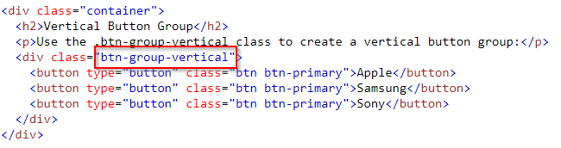
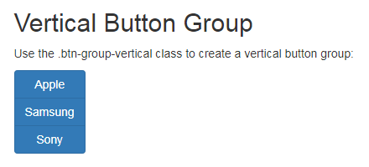
Vertical Button Groups
Use the class .btn-group-vertical to create a vertical button group

Slide 10
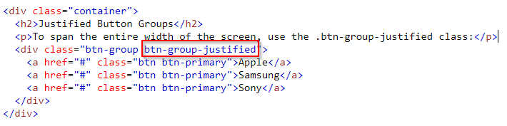
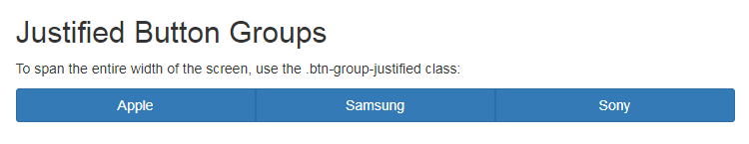
Justified Button Groups(1/3)
To span the entire width of the screen, use the .btn-group-justified class
Remember anything similar before?

Slide 11
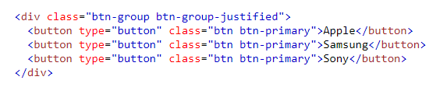


Justified Button Groups(2/3)
Try to make justified button group with <button>

Slide 12
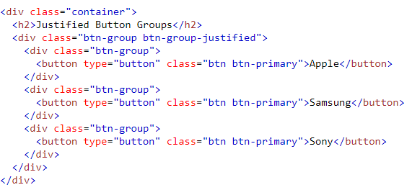
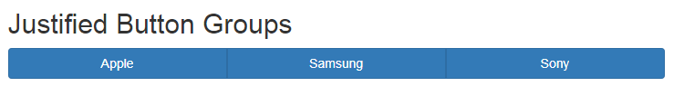
Justified Button Groups(3/3)
For <button> elements, you must wrap each button in a .btn-group class
Notes:
<!DOCTYPE html>
<html lang="en">
<head>
<title>Bootstrap Example</title>
<meta charset="utf-8">
<meta name="viewport" content="width=device-width, initial-scale=1">
<link rel="stylesheet" href="https://maxcdn.bootstrapcdn.com/bootstrap/3.3.7/css/bootstrap.min.css">
<script src="https://ajax.googleapis.com/ajax/libs/jquery/3.2.1/jquery.min.js"></script>
<script src="https://maxcdn.bootstrapcdn.com/bootstrap/3.3.7/js/bootstrap.min.js"></script>
</head>
<body>
<div class="container">
<h2>Justified Button Groups</h2>
<div class="btn-group btn-group-justified">
<div class="btn-group">
<button type="button" class="btn btn-primary">Apple</button>
</div>
<div class="btn-group">
<button type="button" class="btn btn-primary">Samsung</button>
</div>
<div class="btn-group">
<button type="button" class="btn btn-primary">Sony</button>
</div>
</div>
</div>
</body>
</html>

